Slide 1

SmartSell
- Revolutionizing the Home Buying & Selling Experience
Presented By –
Megha Chandrasekharan Nair
Noah T Brown
Sriram Ganeshalingam
Teja Kuragayalabathi
Vishala Vemuri

Slide 2
PROJECT PROPOSAL RECAP
BUSINESS MODEL
Early movers, job changers, growing families,
DATA ANALYSIS
Metro level data analysis using redfin market data
Top metros shortlisted – Minneapolis, Dallas, Houston, Phoenix, Chicago, Atlanta
Core features, core value proposition - https://smartsell-app.vercel.app/

Slide 3
POST PROPOSAL STEP 1: Forecast economic indicators
Migration: Forecast IRS net inflows using Holt’s, ARIMA, and Prophet; best model selected by MAPE.
Population: ACS metro populations forecast with damped exponential smoothing; bias-corrected.
Prime-Age Talent (25–44): Forecast inflow of working-age movers using Holt/ARIMA.
Income: CPI + U.S. income forecast with ARIMA; metro incomes predicted via SARIMAX.
Unemployment: SARIMAX with CPI + recession/pandemic indicators to model labor-market stability.
Housing Prices: Weekly Zillow data modeled via tuned Prophet; aggregated to annual medians.

Slide 4
POST PROPOSAL STEP 2:Metro Finalization
How the Score Was Built
Min–max normalization applied to all the economic factors.
Weighted model reflects strategic priorities:
Persona
Migration
Income
Unemployment
Population
House prices
Previous stability score

Slide 5
OUR TOP SUITABLE METROS
Dallas – strongest demand + stability
Atlanta – high growth & migration inflows
Phoenix Followed by: Houston → Minneapolis → Chicago

Slide 6
PROJECT OUTLINE - ACQUISITION TARGETS
Final Two-Year Acquisition Plan
Year 1: 300 homes (Dallas only)
Year 2: 380 homes total
Dallas: 200
Atlanta: 180
Benchmarking Approach- Offerpad’s 2024 operations and Zillow’s house sales data

Slide 7
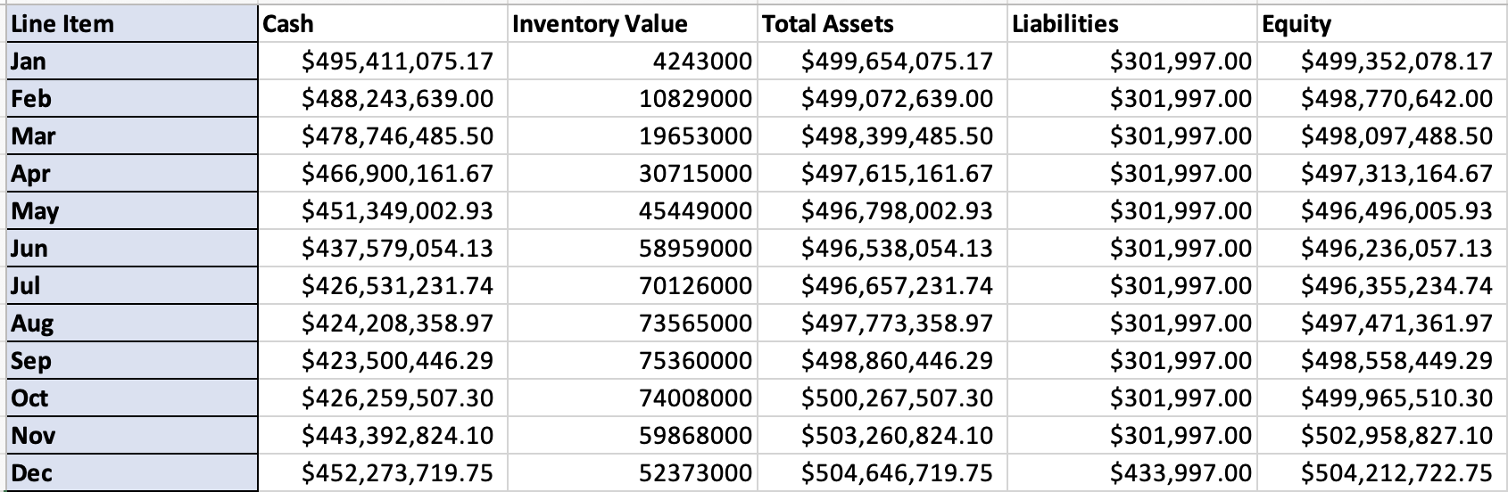
FINANCIAL STATEMENTS – BALANCE SHEET 2026

Slide 8
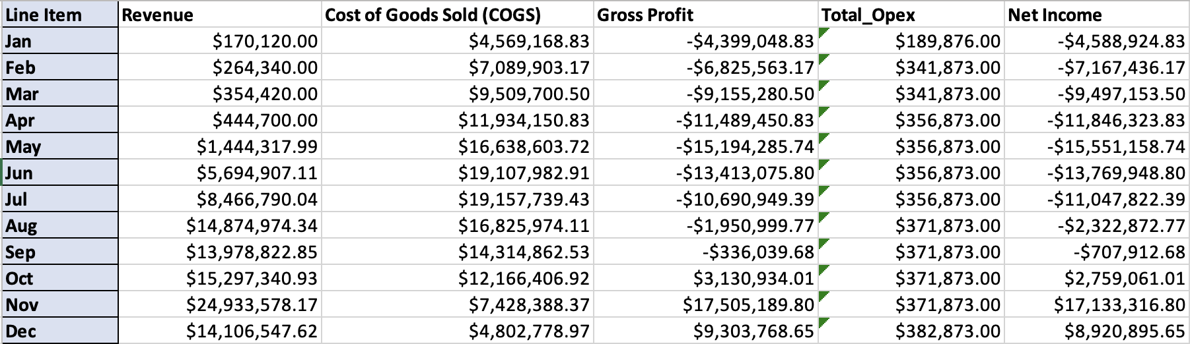
FINANCIAL STATEMENTS –INCOME STATEMENT 2026

Slide 9
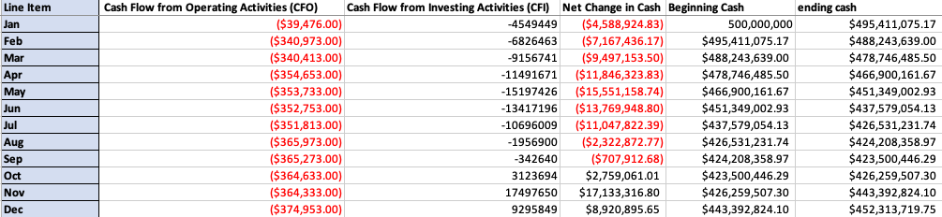
FINANCIAL STATEMENT - CASH FLOW FOR 2026

Slide 10
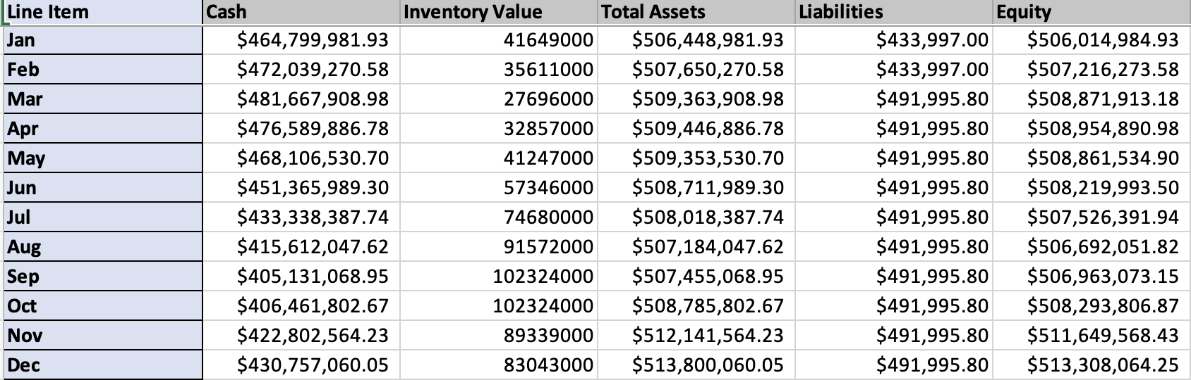
BALANCE SHEET FOR 2027

Slide 11
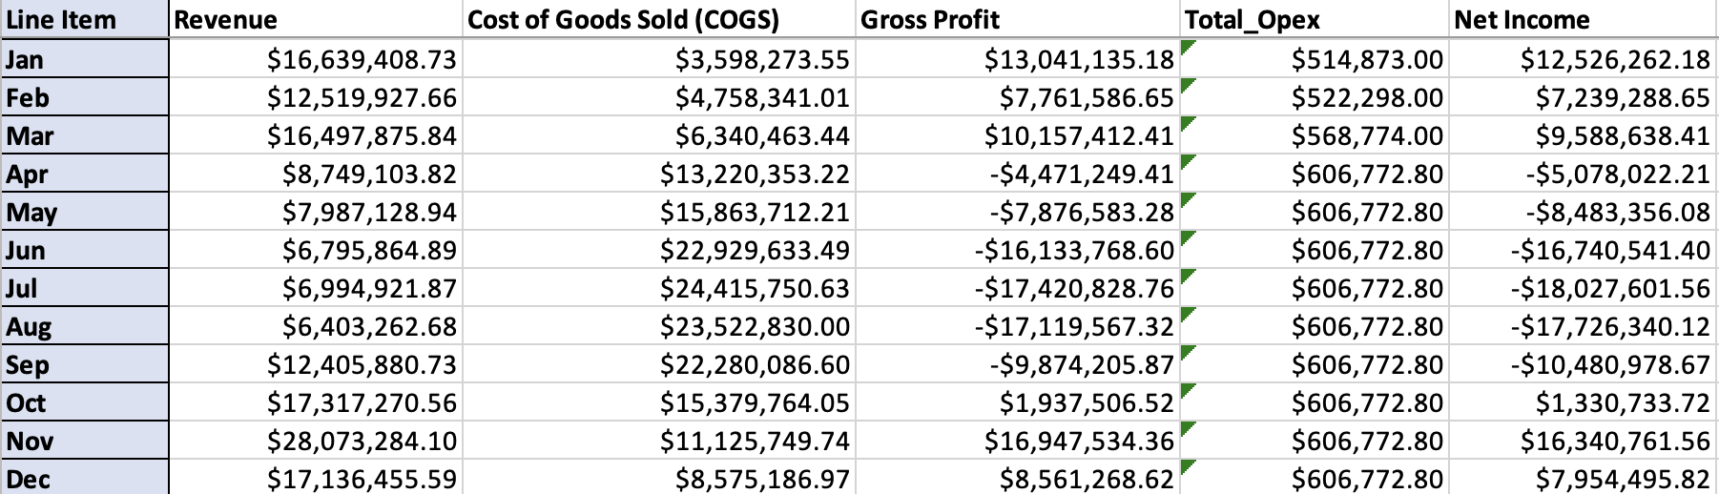
INCOME STATEMENT FOR 2027

Slide 12
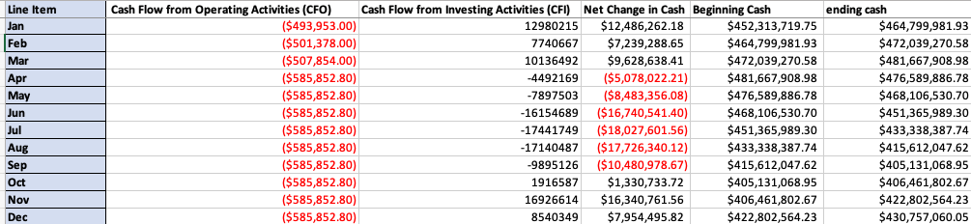
CASHFLOW FOR 2027

Slide 13
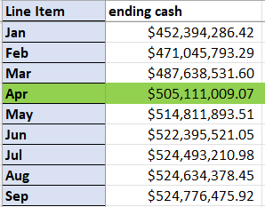
BREAKEVEN
Month 28: This marks the point at which SmartSell has fully recovered all net cash outflows and begins generating net positive returns.
By the end of 33rd month, we generated around 19.6M (after taxes) from our business out of the ~100M we deployed, which is around 19.6% percent ROI.

Slide 14
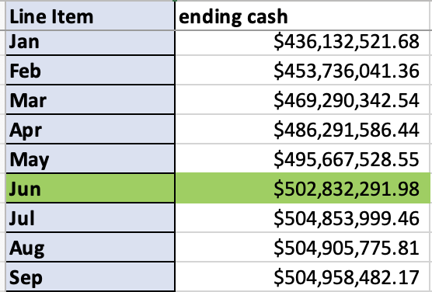
BREAKEVEN WITH LOSSES
Month 30: This marks the point at which SmartSell has fully recovered all net cash outflows and begins generating net positive returns.
By the end of 33rd month, we generated around 3.91M (after taxes) from our business out of the ~100M we deployed, which is around 4% percent ROI.

Slide 15

KPIs
1. Avg. Gross Profit per Unit.
2. Avg. Days to Sell
3. ROI on Renovation/Capex 4. Subscriptions & Subscription Revenue 5. Holding Costs as % of Sale Value
6. Net Profit Margin 7. Total Revenue 8. ROAS (Return on Ad Spend) 9. Customer Acquisition Cost (CAC) 10. Operations Growth Rate

Slide 16

Conclusion
Data-driven scoring identifies Dallas and Atlanta as the strongest markets for initial iBuyer expansion.
Acquisition targets are grounded in real market absorption and benchmarked against established iBuyers.
Financial modeling shows a clear breakdown of the health of our business.
Our KPI framework provides a clear roadmap for optimizing unit economics, holding costs, CAC, and operational efficiency.
SmartSell is positioned for controlled, strategic growth, with a planned expansion into Phoenix, Houston, and Chicago over the next three years.

Slide 17
Q & A

